Slide 1

DATABASE SYSTEM Topic: Advanced database normalization
Presented BY:
Meerub Waseem_036
talal ahmad naeem _037
abeera saeed _008
Submitted to :
SIR Shahid javed
Department of software engineering

Slide 2
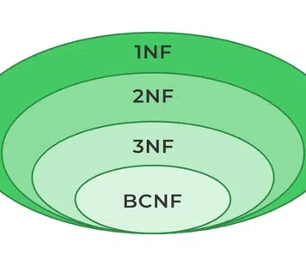
Introduction
What is Normalization.?
Definition:
Normalization is the process of organizing data in a database to reduce redundancy and improve efficiency.
Problems Without Normalization
Problems:
Same data repeated many times
Wastage of storage
Difficult to update data correctly
Benefits With Normalization
Benefits:
Data stored once
Tables are clean and organized
Easy to maintain

Slide 3
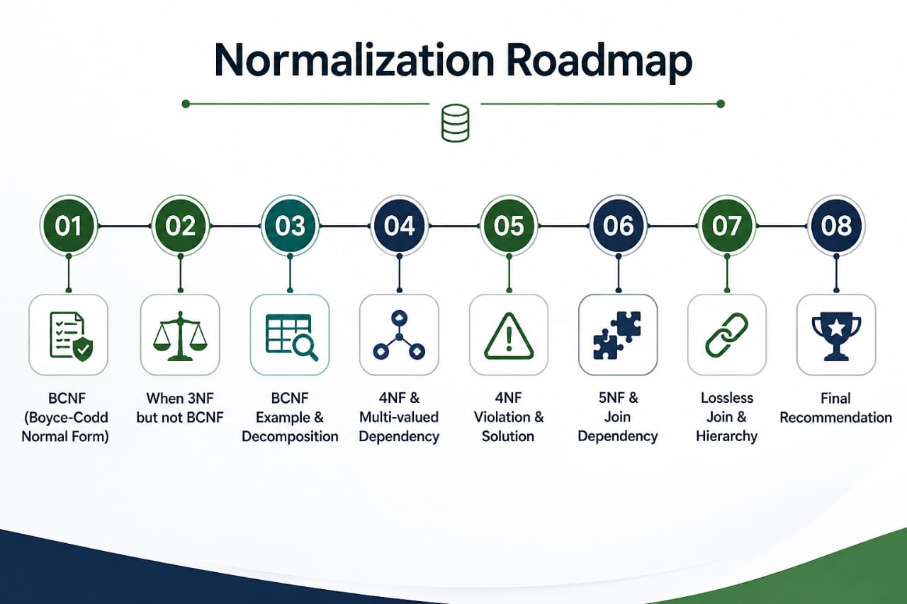
the Roadmap
What We Will Explain Today
Topics:
BCNF (Boyce-Codd Normal Form)
When 3NF but not BCNF
BCNF Example & Decomposition
4NF & Multi-valued Dependency
4NF Violation & Solution
5NF & Join Dependency
Lossless Join & Hierarchy
Final Recommendation

Slide 4
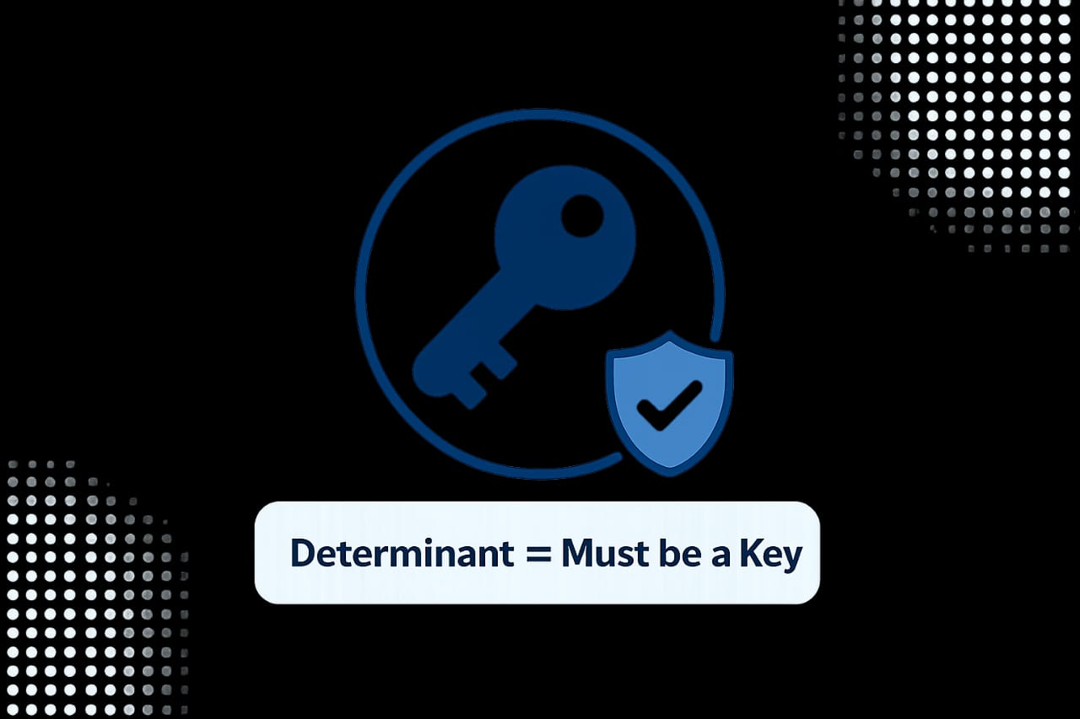
Introduction to bcnf
Example:
CourseID → Instructor
So CourseID must be Candidate
Conclusion:
BCNF removes redundancy caused by functional dependencies and creates a stronger database design. Key
Definition: | BCNF stands for Boyce- codd Normal Form. It is a stronger version of 3NF.
Rule: | Every Determinant must be a candidate key.
Meaning: | If one column determines another , first must be a candidate key.

Slide 5
WHEN 3nf but not bcnf
When 3NF is NOT BCNF
A table can be in 3NF but NOT in BCNF when there are overlapping composite candidate keys.
What does "overlapping composite keys" mean?
A composite key is a key made of two or more columns.
Overlapping means the two keys share at least one common column.
Example Table: Student Course
StudentID | CourseID | Instructor
101 | DB | Sir Shahid
101 | OOP | Sir Waleed
102 | DB | Sir Shahid

Slide 6
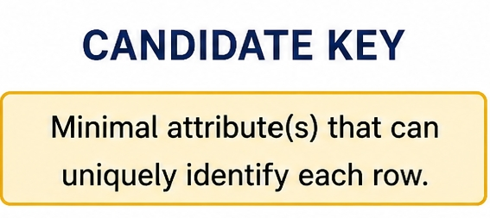
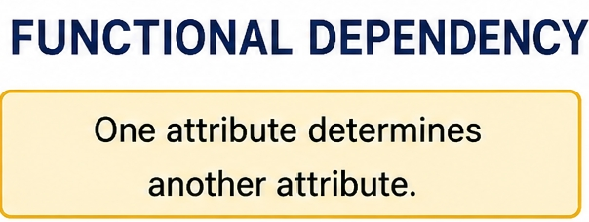
WHEN 3nf but not bcnf
Candidate Keys:
(StudentID, CourseID)
(StudentID, Instructor)
Functional Dependency
CourseID → Instructor
The Problem:
CourseID determines Instructor
But CourseID is NOT a candidate key by itself
CourseID alone cannot uniquely identify a row
Result: 3NF is better than BCNF.

Slide 7
BCNF example & decomposition
Wrong Table (Not In BCNF):
Functional Dependency:
ZipCode → City
Why is this wrong?
ZipCode determines City
But ZipCode is NOT a candidate key
City is repeated unnecessarily
This violates BCNF
City | Street | Zip Code
Lahore | Mall Road | 54000
Lahore | Jail Road | 54000
Karachi | Shahrah-e-Faisal | 75000

Slide 8
BCNF example & decomposition
Correct Tables BCNF:
Table 1: Zip Code_ city Table 2: Zip Code _ Street
Result:
No repetition of City
Clean structure
Lossless Join possible
ZipCode | City
54000 | Lahore
75000 | Karachi
ZipCode | Street
54000 | Mall Road
54000 | Jail Road
75000 | Shahrah e-Faisal

Slide 9
4nf (Fourth Normal Form)
Definition:
4NF (Fourth Normal Form) is a level of database normalization that builds on BCNF.
Formula:
4NF = BCNF + No Multi-valued Dependencies
In Simple Words:
A table is in 4NF if:
It is already in BCNF
It contains no multi-valued dependencies (these are not allowed)
Why do we need 4NF?
BCNF removes problems caused by functional dependencies. But there is another type of problem caused by multi-valued dependencies. 4NF removes those problems.

Slide 10

Multi value –Dependency
What is a Multi-valued Dependency?
Definition:
A multi-valued dependency (MVD) occurs when one attribute (X) determines multiple independent values of another attribute (Y).
Symbol:
X →→ Y
Example:
One Employee can have multiple Skills
· The same Employee can have multiple Languages
The Key Point:
Skills and Languages are independent of each other.

Slide 11
Multi value –Dependency
Table:
In this table:
· EmpID →→ Skill (Each employee has multiple skills)
· EmpID →→ Language (Each employee has multiple languages))
Email_ID | Skill | Language
101 | Java | English
101 | Java | Spanish
101 | Python | English
101 | Python | Spanish

Slide 12
4NF - violation
Wrong Table not in 4NF Title: 4NF Violation – Employee-Skill-Language
What's happening?
Employee 101 has Skills: {Java, Python}
Employee 101 has Languages: {English, Spanish}
Every skill is paired with every language → 4 rows for one employee
The Problem (Data Explosion):
Add new skill C++ → need 2 new rows (English + Spanish)
Add new language French → need 2 new rows (Java + Python)
Table grows unnecessarily fast
Result: This is a 4NF violation .
Email ID | Skills | Language
101 | java | English
101 | java | Spanish
101 | python | English
101 | python | Spanish

Slide 13
4nf- decomposition
Title: The Fix – 4NF Decomposition
Tables in 4NF
Table 1: Employee_ skill Table 2: Employee_ Language
Result:
No duplication
Easy updates
Add new skill → 1 row
Add new language → 1 row
Much better structure
EMP ID | Skill
101 | Java
101 | Python
EMP ID | Language
101 | English
101 | Spanish

Slide 14
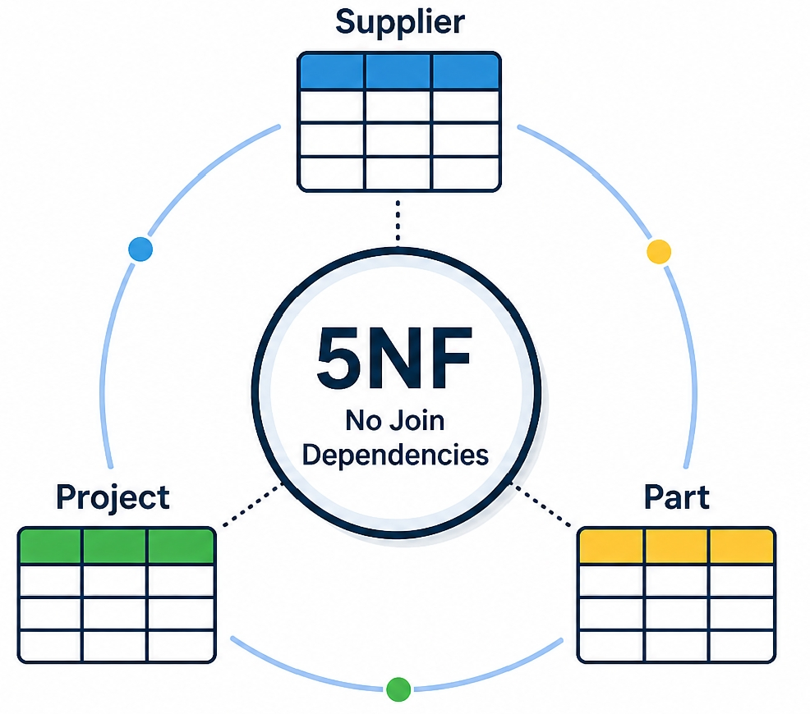
5NF & JOIN DEPENDENCY
Definition of 5NF:
A table is in 5NF when it cannot be decomposed further without losing information.
Formula:
5NF = 4NF + No Join Dependencies
What is a Join Dependency?
A table can be split into 3 or more tables
Joining all of them gives back the original
If you miss one, you lose information
Example: Example of 5NF & Decomposition is as follow:
Multiple relationships are mixed in one table
Student–Course, Course–Teacher, Student–Teacher
This creates join dependency
Student | Course | Teacher
S1 | DB | T1
S1 | OOP | T2
S2 | DB | T1

Slide 15
5NF Example & Decomposition
Decomposition:
Table 1: student_course Table 2: course_teacher Table 3: student_teacher
Key Points:
Tables split into smaller relations
No data loss after join
This is called 5NF
Conclusion:
5NF provides a perfect database structure by removing join dependency, but it is rarely used in real-world systems because it is complex and usually unnecessary.
student | course
S1 | DB
S1 | OOP
S2 | DB
Course | Teacher
DB | T1
OOP | T2
Studen | Teacher
S1 | T1
S1 | T2
S2 | T1

Slide 16
Lossless join & normalization hierarchy
What is Lossless Join?
When you decompose a table using normalization rules
You can rejoin (NATURAL JOIN) the pieces
You get back exactly the original rows
No extra fake rows (spurious tuples)
The Normalization Hierarchy:
5NF ← Highest (rarely used)
↑ 4NF ← Removes multi-valued dependencies
↑ BCNF ← Removes tricky functional dependencies
↑ 3NF ← Removes transitive dependencies
↑ 2NF ← Removes partial dependencies
↑ 1NF ← Atomic values only

Slide 17
Final recommendation
What Should We Actually Use?
Normal Forms Recommendation:
1NF, 2NF, 3NF → Use always (basic clean structure)
BCNF → Recommended (safe and strong design)
4NF → Use only in special cases (like multi-valued data problem)
5NF → Rarely needed (too complex, not practical for most systems)
Golden Rule:
For most real-world systems like schools, hospitals, shopping apps, and banking systems
→ BCNF is enough.
Conclusion:
A simple and well-structured database is always better than a very complex design that is hard to manage.
“Keep your database clean, not complicated.”

Slide 18
Thank you
Do You Have Any questions ?

